Slide 1
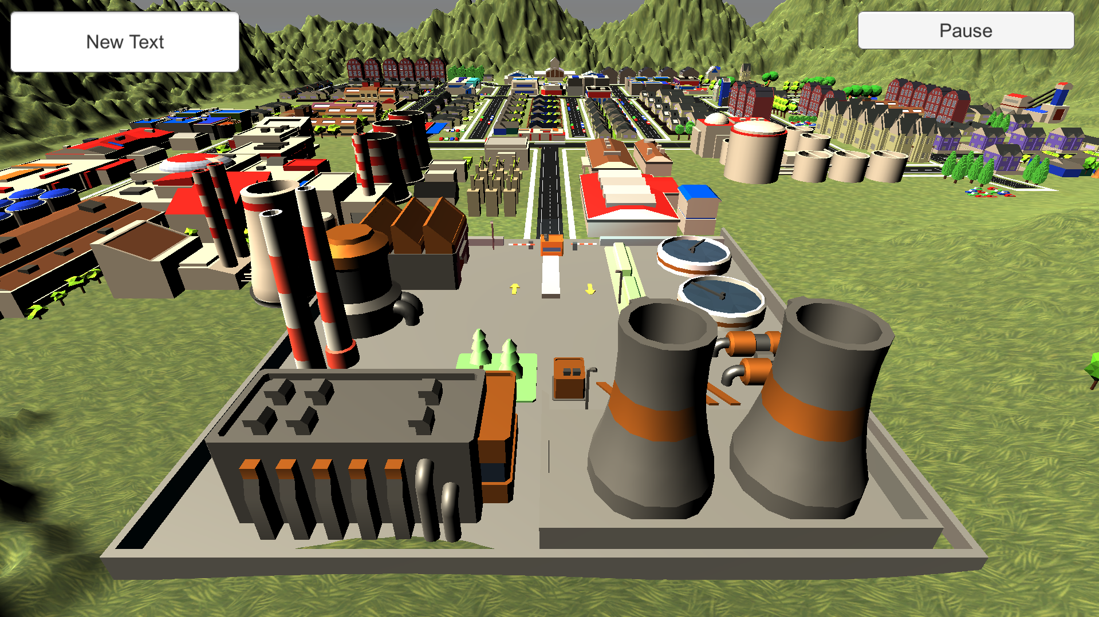
Player: Sam Score: 500
1200
$ 50000
☹ ☺

